Slide 1

CASH-VSU’S FEE TRACKING SYSTEM
BSCS 2-5 Group 3

Slide 2
Introduction
Fee Collection
User-friendly interface
Transparency
Timely reminders
Handling of fee structures

Slide 3
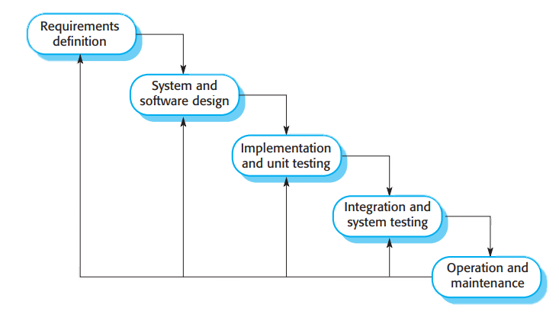
Waterfall Model
METHODOLOGY
It is very simple to understand and use. In a waterfall model, each phase must be completed before the next phase can begin and there is no overlapping in the phases.

Slide 4
Requirements Definition
Sign up
Log in
Admin
Home Section
Due Date Reminder
Fees Overview
Payment Confirmation
Transaction History
Receipt Generation

Slide 5
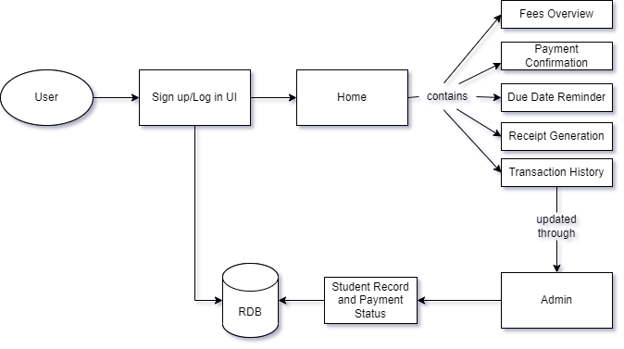
System and Software Design

Slide 6
Implementation and unit testing
Sign up
Log in
Home
Admin
View Fees
Payment Confirmation
Due Date Reminder
Transaction History
Receipt Generation
Log in (Admin access)
Add Fees
Pending Payments
Student Records
Confirm Transaction
Transaction History

Slide 7
Integration and System Testing
All the units developed in the implementation phase are integrated into a system after testing of each unit. Post integration the entire system is tested for any faults and failures.

Slide 8
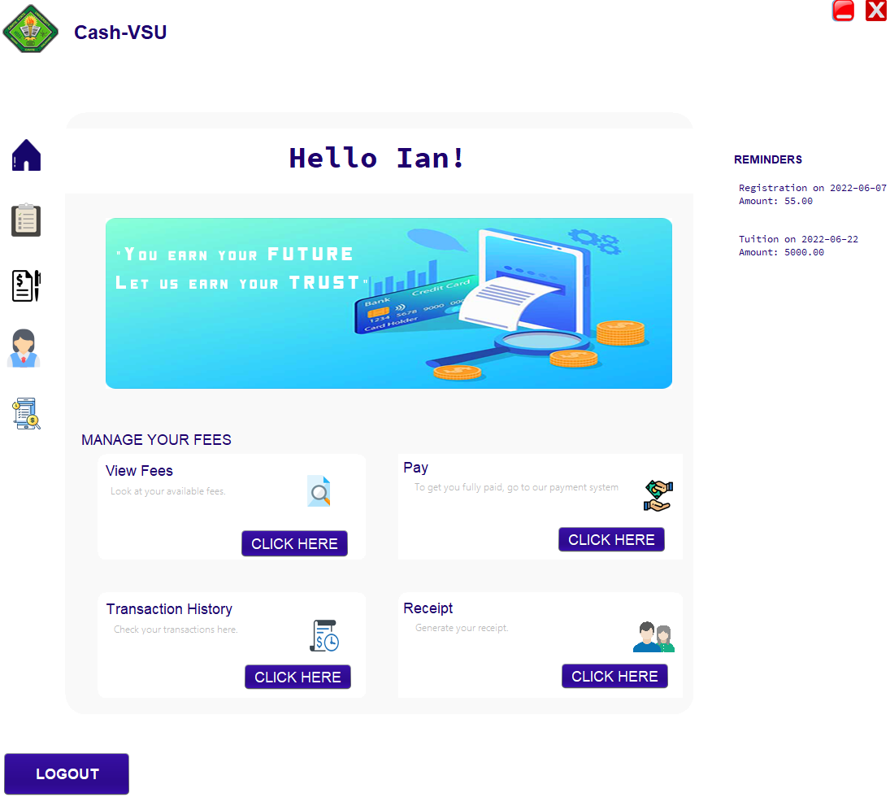
Maintenance
Some issues may come up in the client environment. To fix those issues, patches will be released. Also to enhance the product some better versions will be released.

Slide 9
Start and End of Development
Duration : 1 month, 15 days
Start Date : May 1, 2022
End Date : June 15, 2022

Slide 10
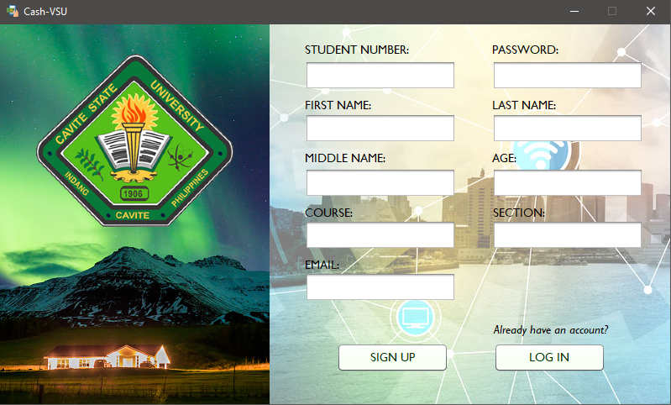
Functionalities
Sign up

Slide 11
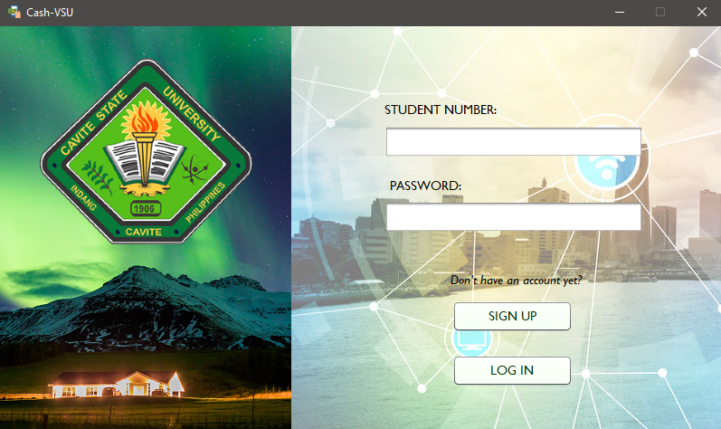
Functionalities
Log in

Slide 12

Functionalities
Home

Slide 13
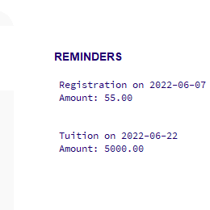
Functionalities
Due Date Reminder

Slide 14
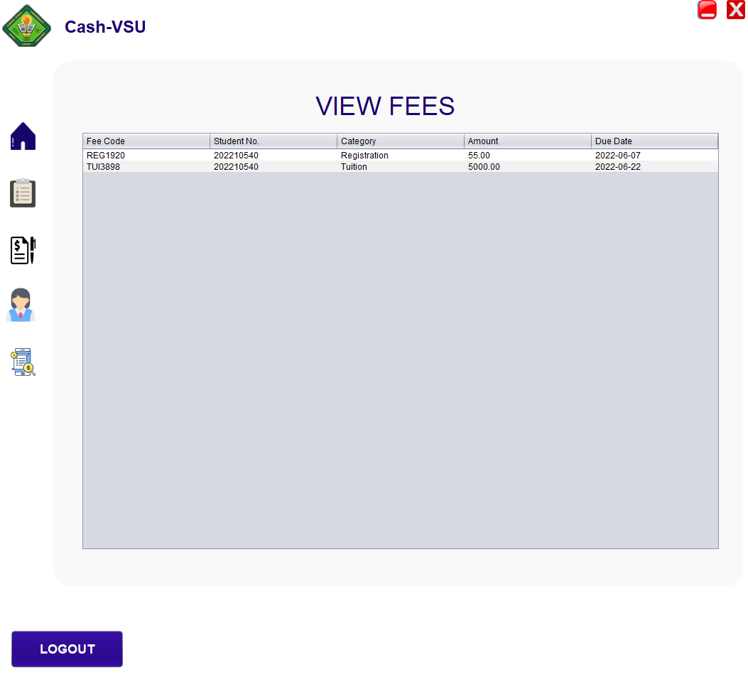
Functionalities
Fees Overview

Slide 15
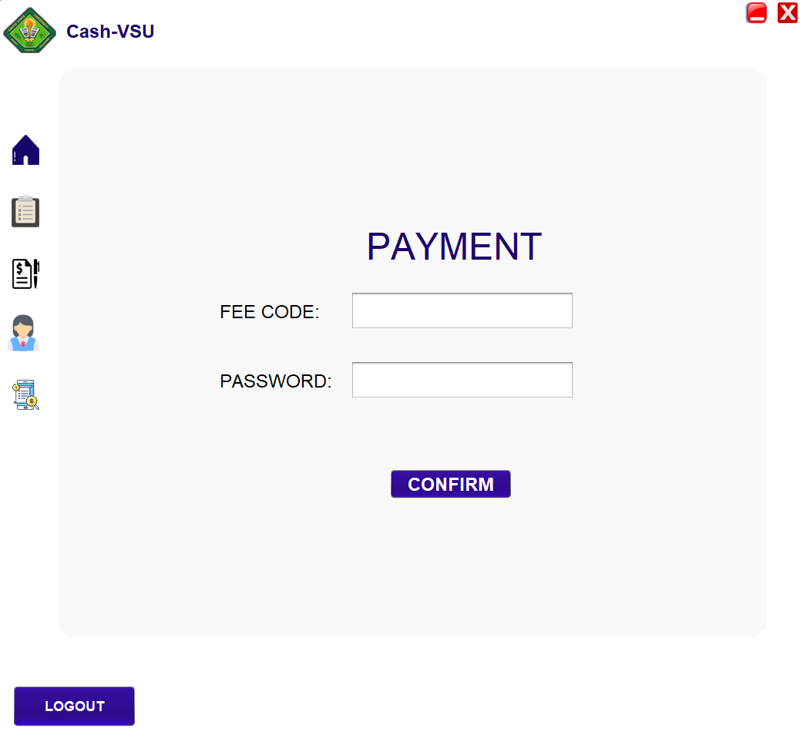
Functionalities
Payment Confirmation

Slide 16
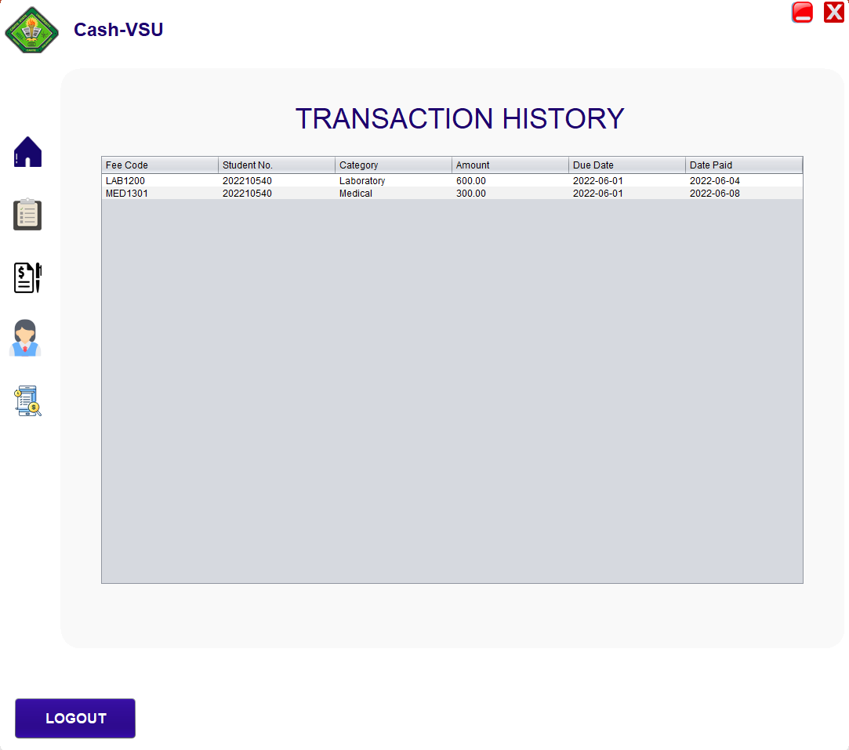
Functionalities
Transaction History

Slide 17
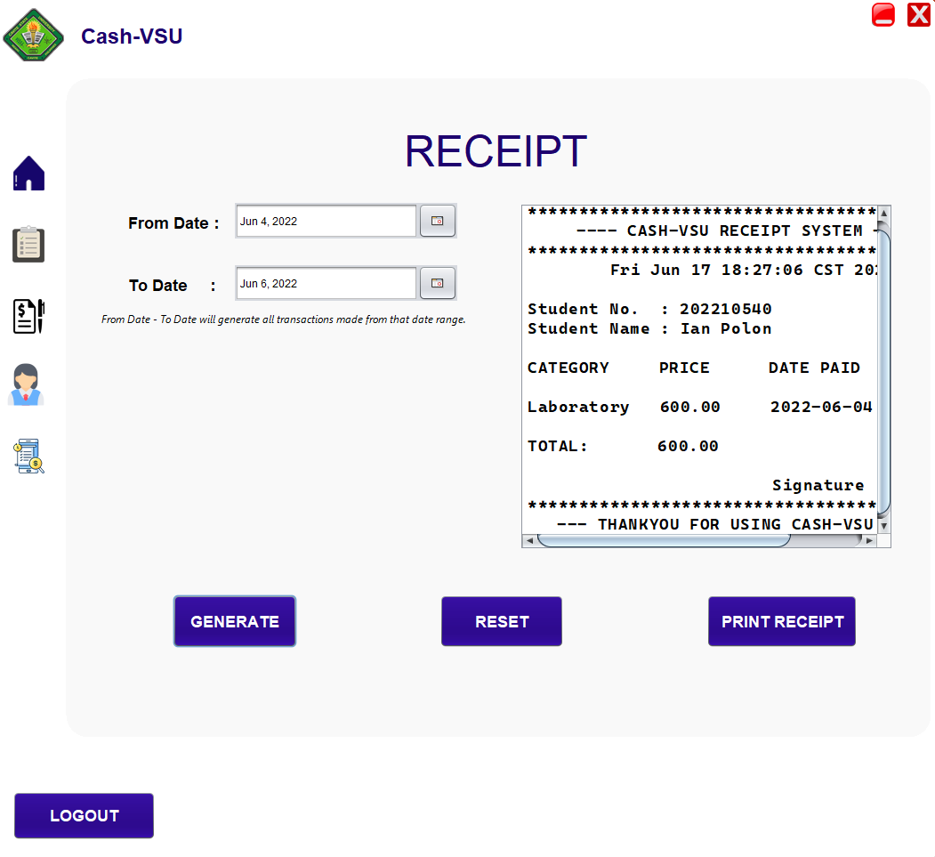
Functionalities
Receipt Generation

Slide 18
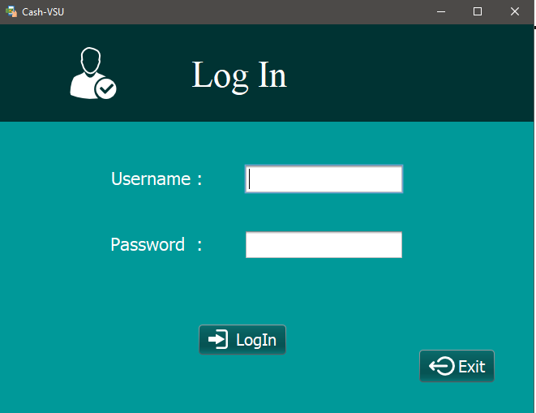
Functionalities
Log in (Admin access)

Slide 19
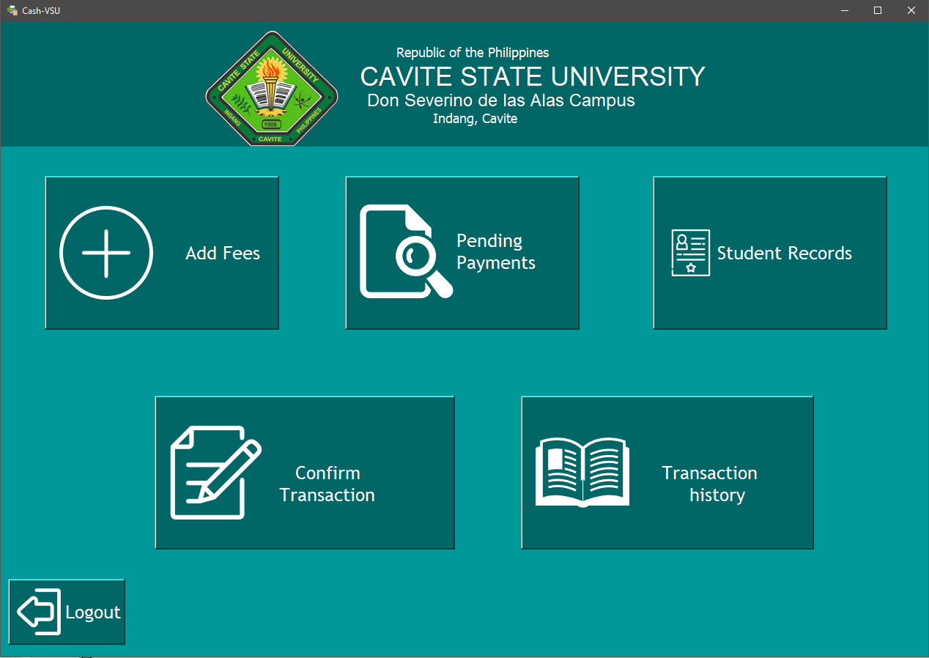
Functionalities
Admin Home

Slide 20
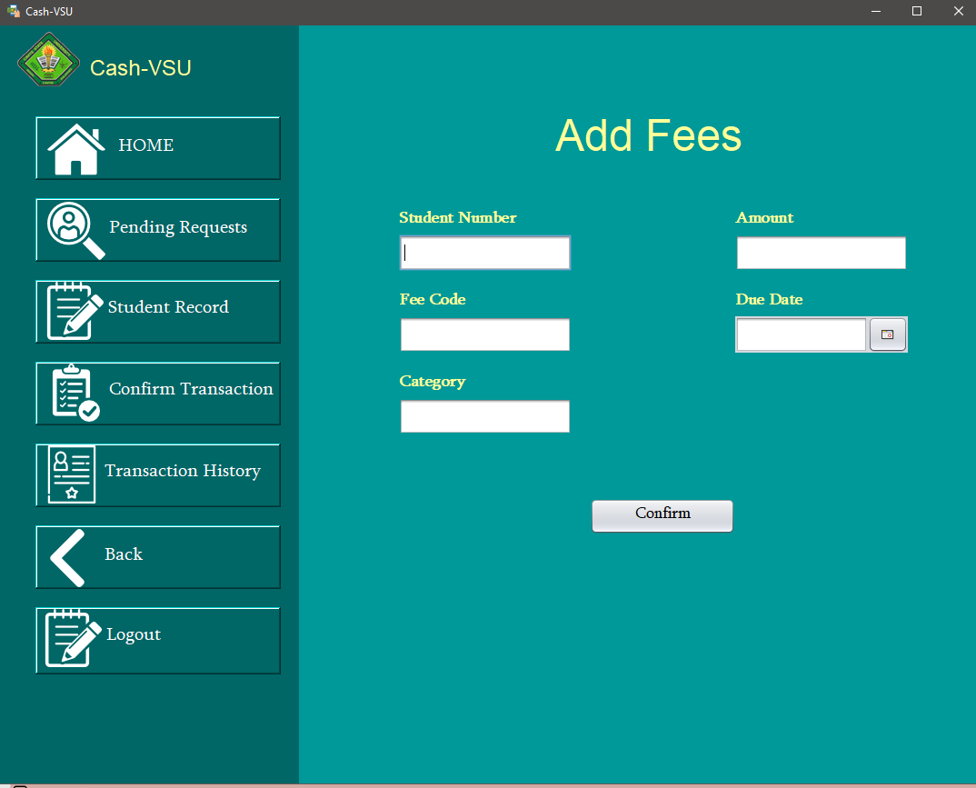
Functionalities
Add Fees

Slide 21
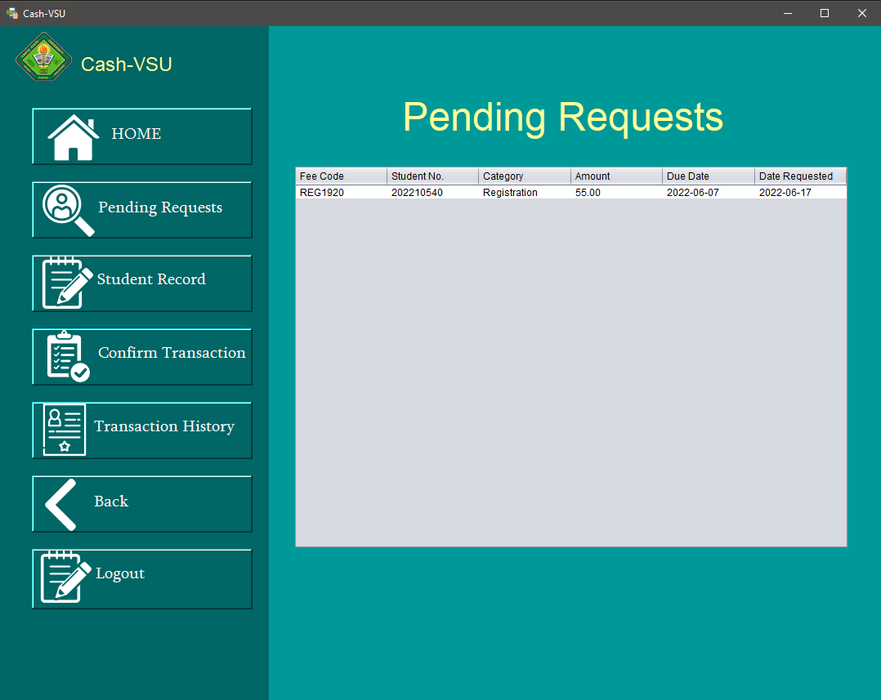
Functionalities
Pending Requests

Slide 22
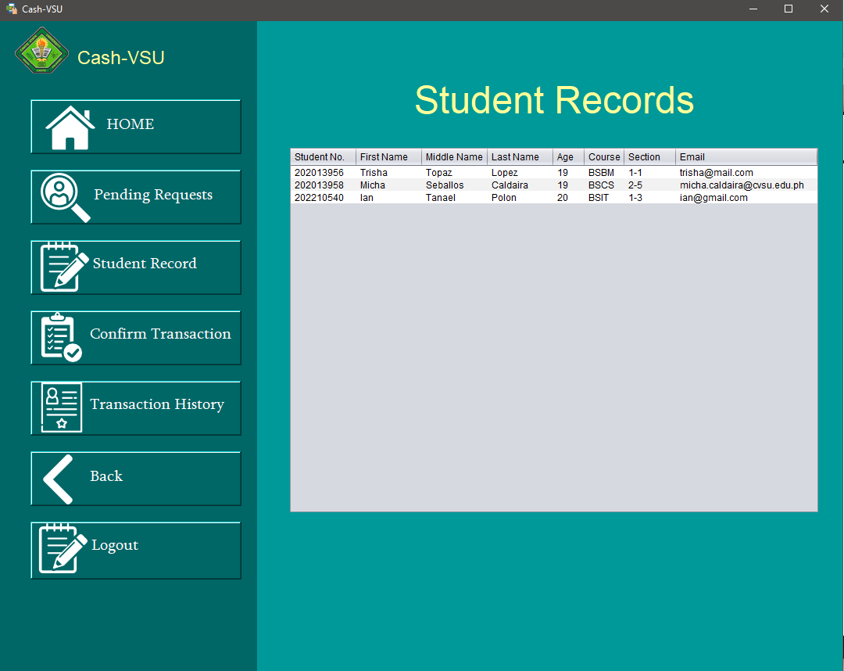
Functionalities
Student Records

Slide 23
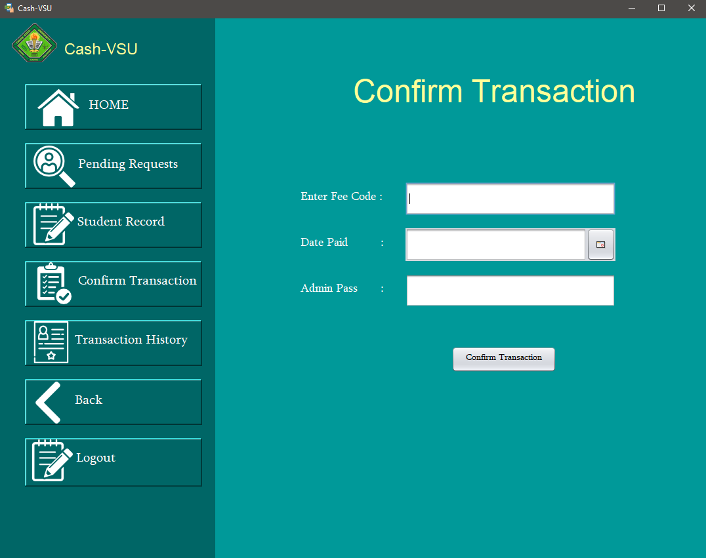
Functionalities
Confirm Transaction

Slide 24
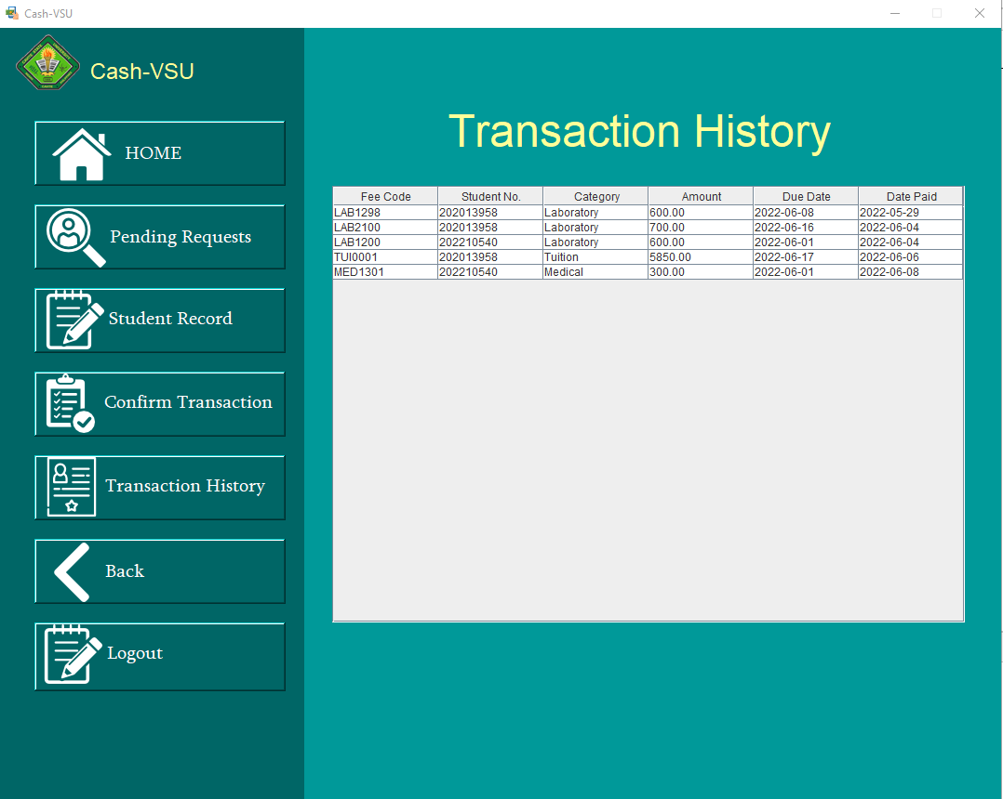
Functionalities
Transaction History

Slide 25
System Demo

Slide 26
Thank you!
Do you have any questions?

